Slide 1

TASk 2 : model development using automl
20/11/2022

Slide 2
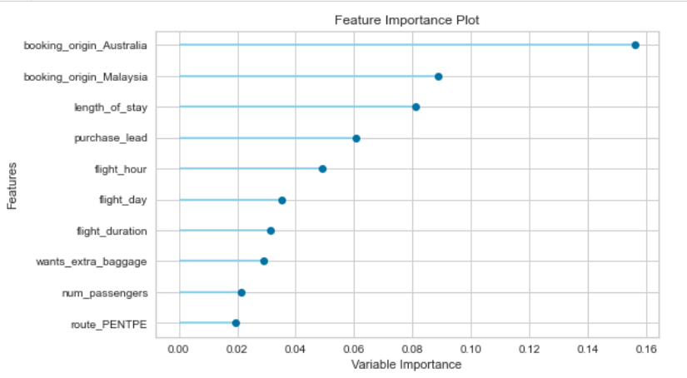
Summary of task 2: Predicting customer bookings
After training and testing several ML models using Pycaret, the famous AutoML library, the results show that random forest classifier (RFC) outperformed other machine learning models in terms of accuracy, precision, recall, and area under the curve (AUC) score. The table below shows our final findings.
The results might look a bit unsatifsfied for the company because the dataset we have is very impalanced. The majority of observations (85%) represents customers who have not made their bookings. So we may think of another strategy to balance the dataset such as augmentating data for the minority class or undersampling.
The graph below shows the most important features to consider for booking prediction.
Accuracy | Precision | Recall | AUC Score
0.7838 | 0.3453 | 0.4961 | 0.7665

